Slide 1


CHARGE Edu-Tech Intern’s
CHARGE Edu-Tech Internship
Name- UMME KULSUM
Cloud Computing Intern
Batch- April 2023

Slide 2
Project-1 Cloud Based Book Store.
The Online book shop system is a simple project developed in PHP and My SQL by using the following, HTML, CSS, JavaSript, Ajax, Bootstrap, and Modal, the system made to speed up the book booking process, the user first need to sign up before going to continue borrowed the book, the system contains of admin and user the admin can manage, all data in system, the user is represent as staff and user, from online.

Slide 3
The Story Shop.
Language: PHP, Html
Database: My SQL
Design Interface: Bootstrap Javascript, Html, Ajax, JQuery
Browser: Microsoft Edge
Software: XAMPP
Copy and Paste all the files from the GitHub Repository in a Folder Named Book_shop.
And Paste this folder in the inside Root directory where xampp was installed. Ex. In local disk C: paste in xampp/htdocs.

Slide 4
Open PHPMyAdmin http://localhost/phpMyAdmin
Create database name book_shop_db
Import book_shop_db.sql file given in the Repository
Run the script http://localhost/book_shop/ -HomePage
http://localhost/book_shop/admin/login.php -AdminLoginPage
in any Browser.
Password: username:admin / password :admin123

Slide 5
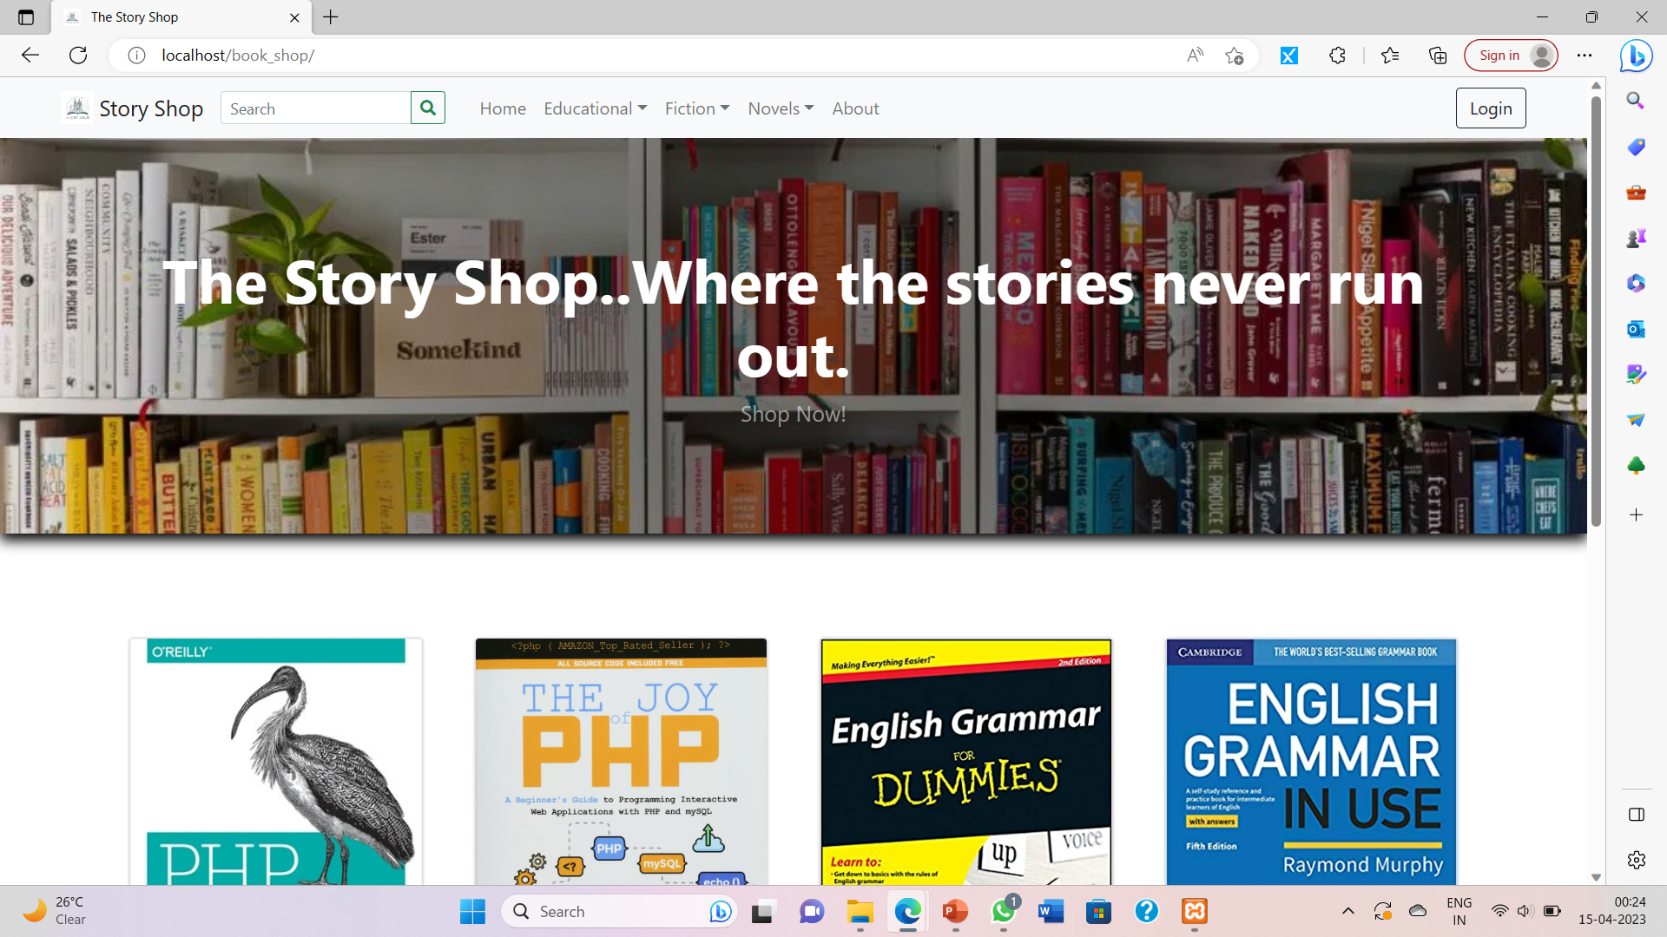
Snapshots.

Slide 6
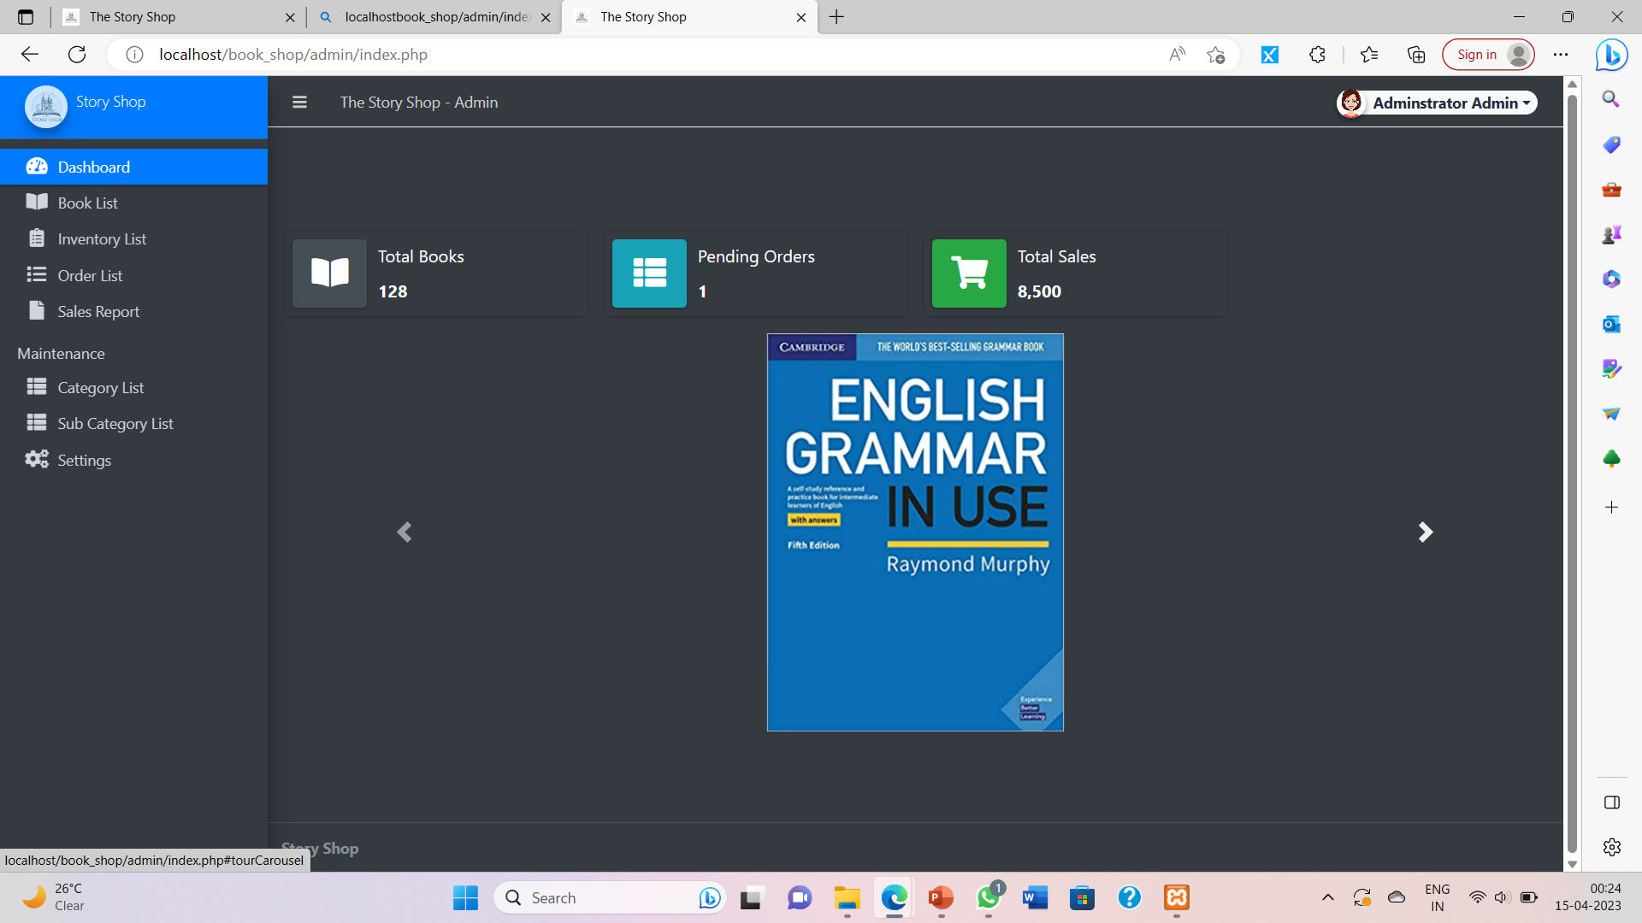
Snapshots.

Slide 7
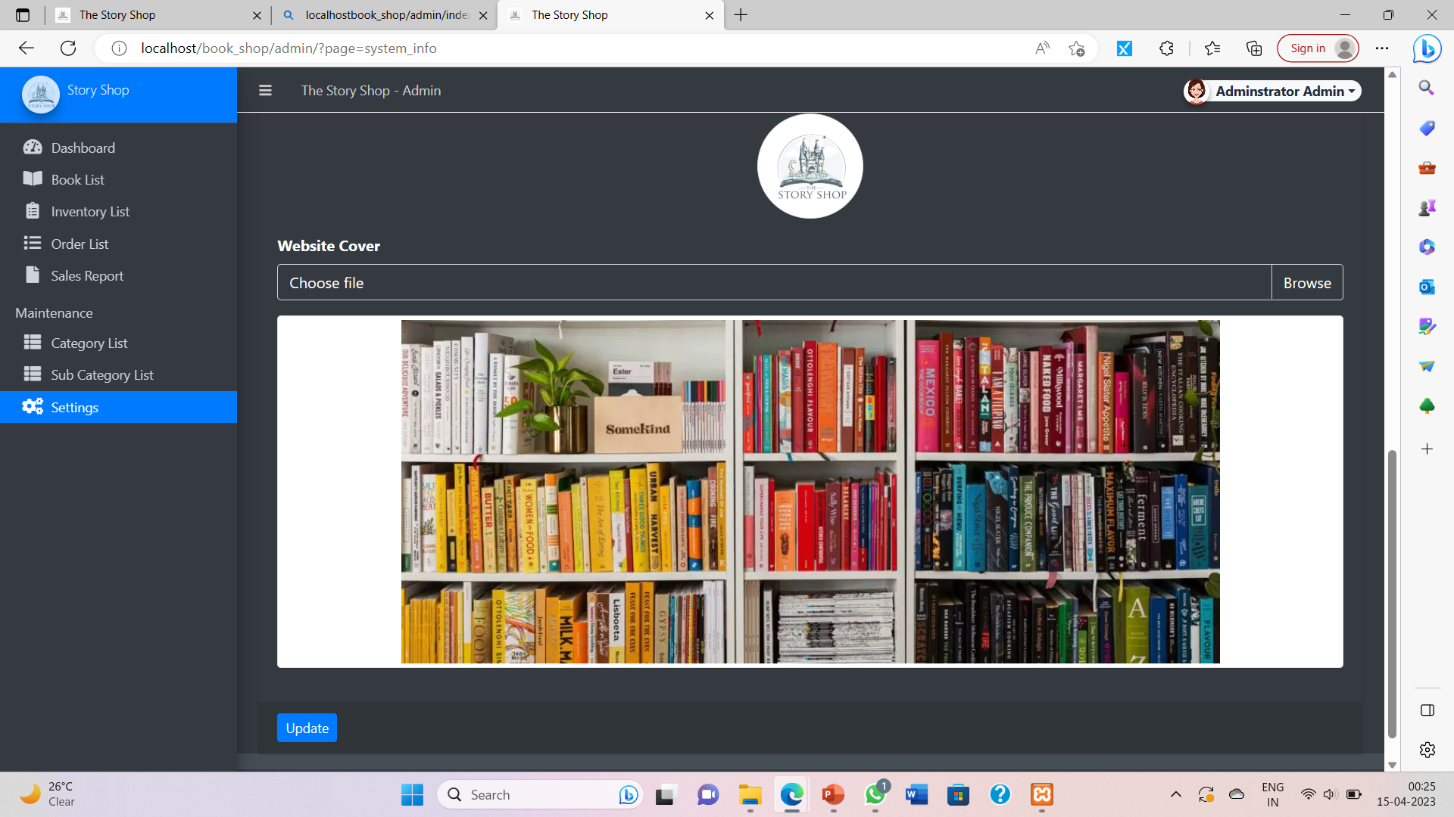
Snapshots.

Slide 8
Thank you.

